Slide 1



MPIG Open Seminar 0110
Dimensionality Reduction
袁洪慧
Machine Perception and Interaction Group (MPIG)
www.mpig.com.cn
yhh@mpig.com.cn
公众号:
mpig_robot

Slide 2
Motivation I : Data compression
Motivation II: Visualization
Principal component analysis problem formulation
Principal component analysis algorithm
Choosing the number of principal components
Reconstruction from compressed representation
Advice for applying PCA

Slide 3
Motivation I:
Data Compression

Slide 4


Data Compression
Reduce data from 2D to 1D
inches)
(
(
cm)

Slide 5
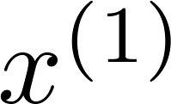
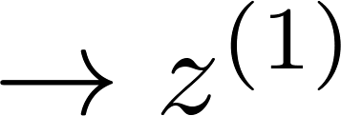
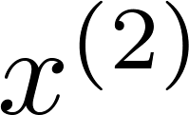
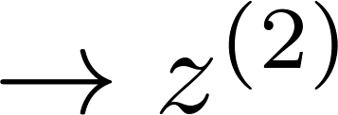
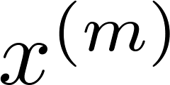
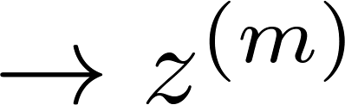

Data Compression
Reduce data from 2D to 1D
inches)
(
(
cm)

Slide 6
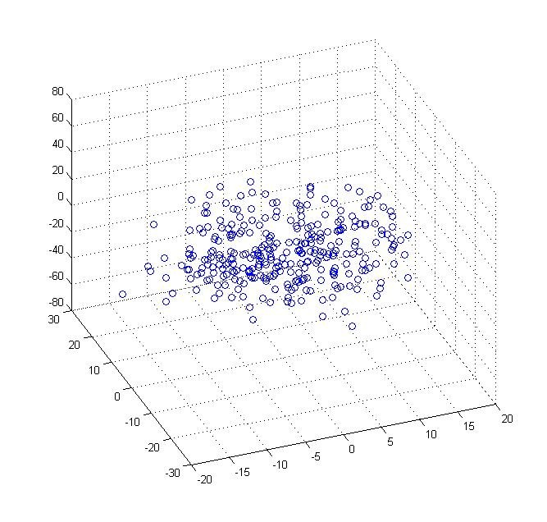
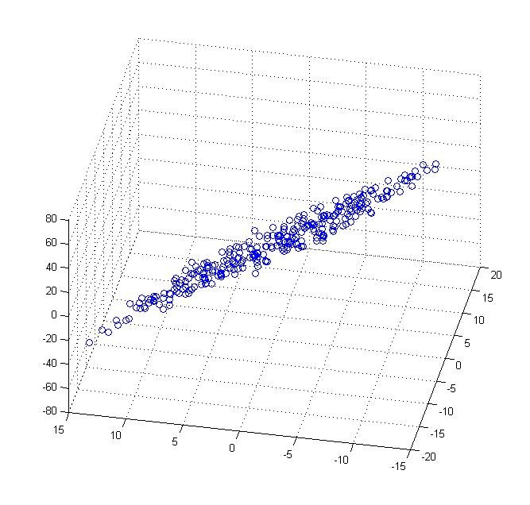
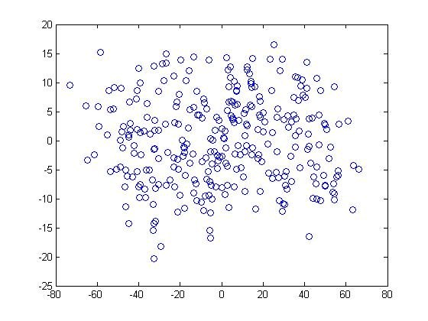
Data Compression
Reduce data from 3D to 2D
X3
X3
Z2
X2
X1
X2
X1
Z1

Slide 7
Motivation II:
Data Visualization

Slide 8
Data Visualization
 | GDP | Per GDP | development index | Life expectancy | Poverty index | Household Income | …
Canada | 1.577 |  | 0.908 | 80.7 | 32.6 | 67.293 | …
China | 5.878 | 7.54 | 0.687 | 73 | 46.9 | 10.22 | …
India | 1.632 | 3.41 | 0.547 | 64.7 | 36.8 | 0.735 | …
Russia | 1.48 | 19.84 | 0.755 | 65.5 | 39.9 | 0.72 | …
Singapore | 0.223 | 56.69 | 0.866 | 80 | 42.5 | 67.1 | …
USA | 14.527 | 46.86 | 0.91 | 78.3 | 40.8 | 84.3 | …
… | … | … | … | … | … | …

Slide 9

Data Visualization
Country
Canada
1.6
1.2
China
1.7
0.3
India
1.6
0.2
Russia
1.4
0.5
Singapore
0.5
1.7
USA
2
1.5
…
…
…

Slide 10
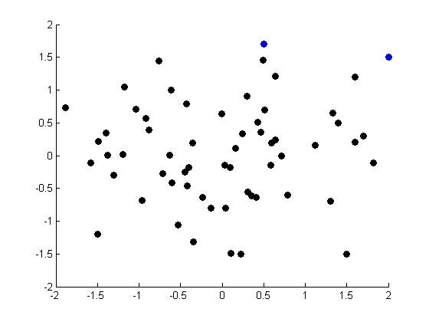
Data Visualization
Z2
Z1

Slide 11
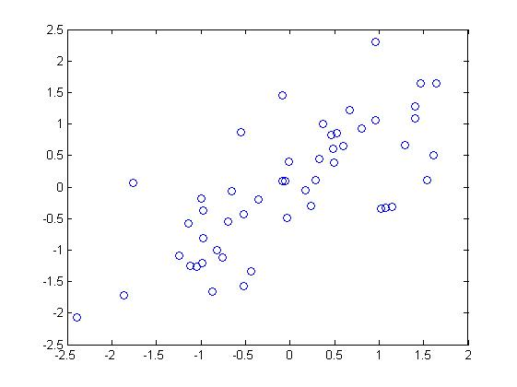
Data Visualization

Slide 12
Principal component
analysis problem formulation

Slide 13
Principal Component Analysis Problem Formulation

Slide 14
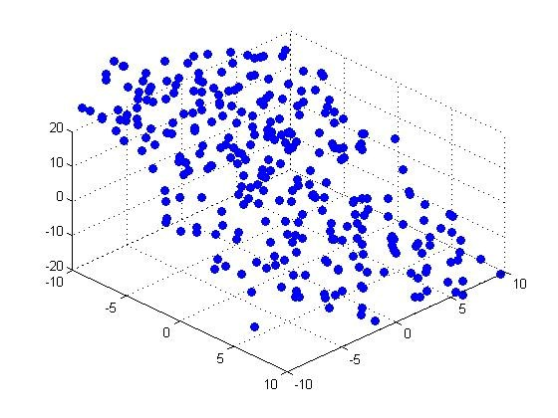

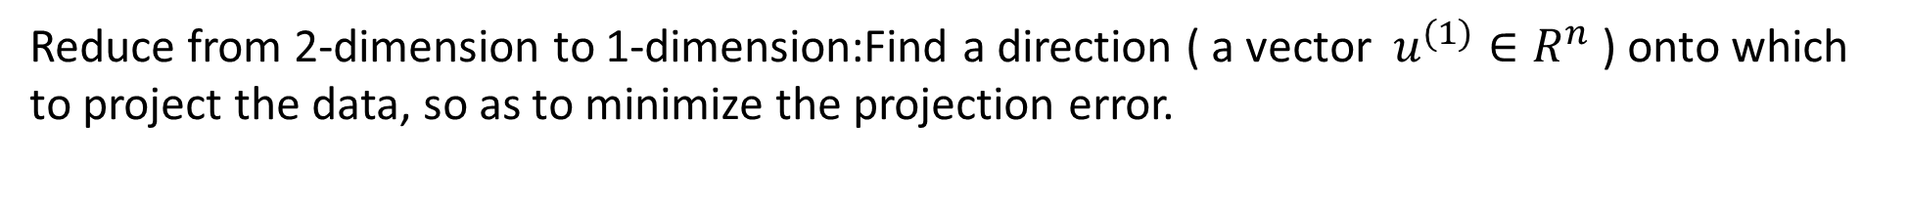
Principal Component Analysis Problem Formulation
Reduce from 2-dimension to 1-dimension:Find a direction ( a vector $u^{(1)}∈R^{n}$ ) onto which to project the data, so as to minimize the projection error.
Reduce from n-dimension to k-dimension : Find k vectors $u^{(1)}u^{(2)}$,……, $u^{(k)}$ onto which to project the data, so as to minimize the projection error.

Slide 15
PCA is not linear regression

Slide 16
PCA is not linear regression

Slide 17
Principal component
analysis algorithm

Slide 18
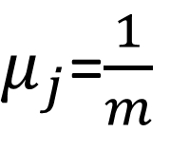
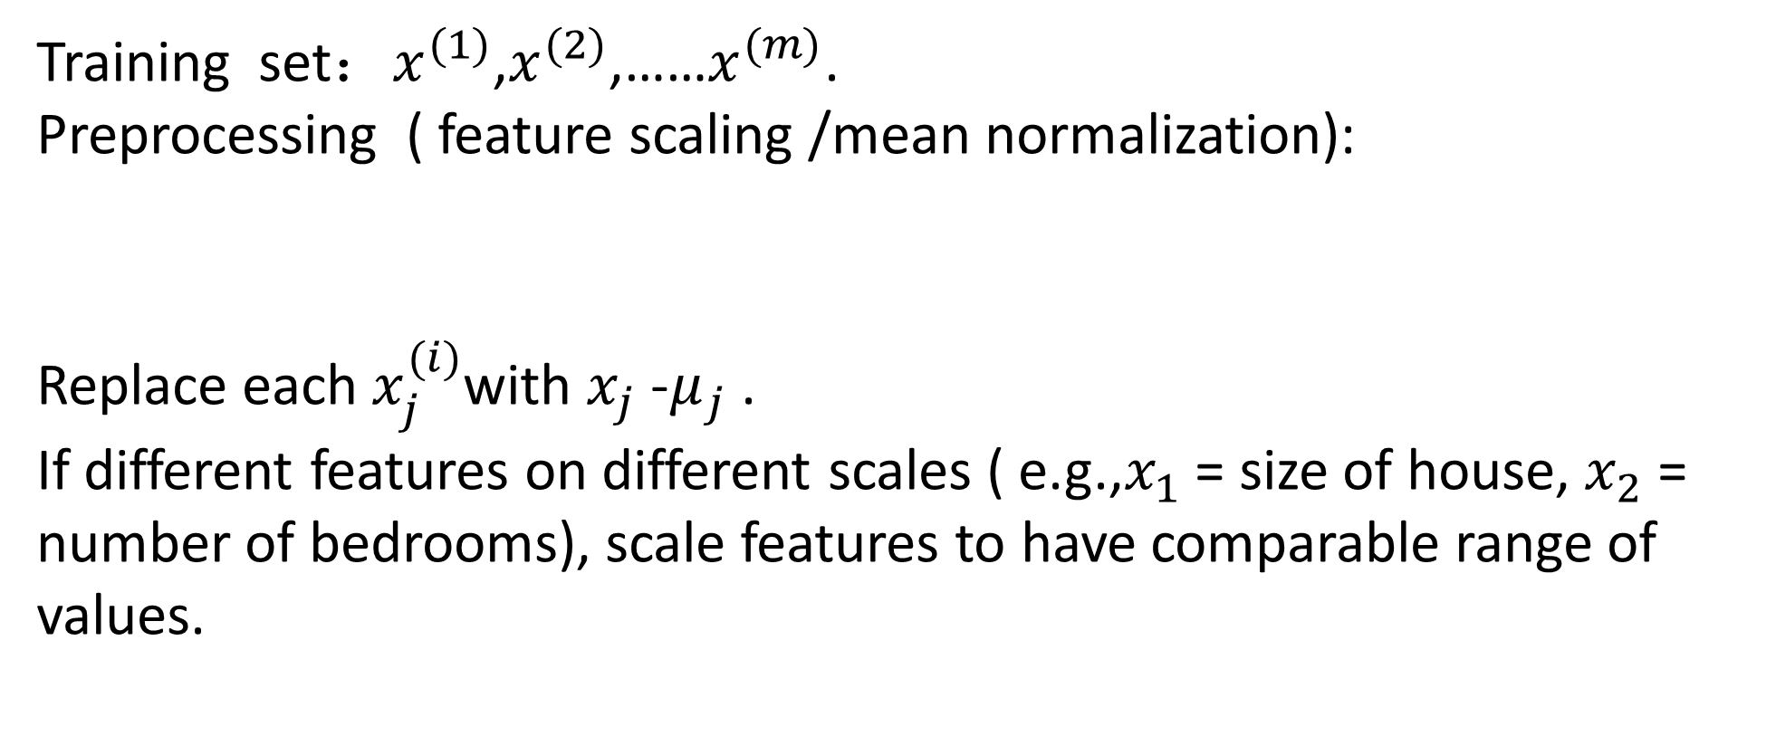

Data Preprocessing
Training set：$x^{(1)}$,$x^{(2)}$,……$x^{(m)}$.
Preprocessing ( feature scaling /mean normalization):
Replace each $x_{j}^{(i)}$with $x_{j}$ -$μ_{j}$ .
If different features on different scales ( e.g.,$x_{1}$ = size of house, $x_{2}$ = number of bedrooms), scale features to have comparable range of values.
$μ_{j}$=$\frac{1}{m}$
$$\sum_{i=1}^{m}{x_{j}^{(i)}}$$

Slide 19
Principal Component Analysis (PCA) Algorithm
p61
p60
Reduce data from 2D to 1D
Reduce data from 3D to 2D

Slide 20
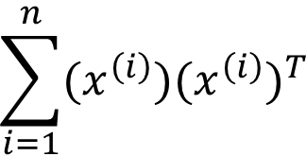
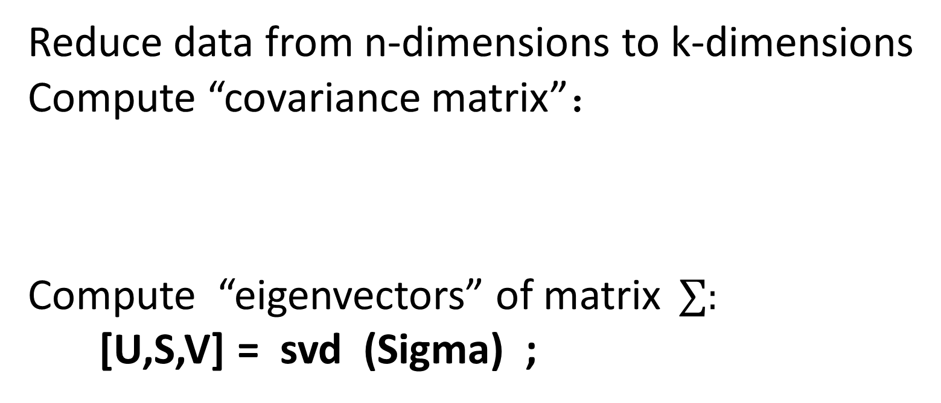

Principal Component Analysis (PCA) Algorithm
Reduce data from n-dimensions to k-dimensions
Compute “covariance matrix”：
Compute “eigenvectors” of matrix$\sum{:}$
[U,S,V] = svd (Sigma) ;
$$\sum{=\frac{1}{m}}$$
$$\sum_{i=1}^{n}{{(x^{\left(i\right)}{)(x}^{\left(i\right)})}^{T}}$$

Slide 21
Feature Normalize Preprocessing
function [X_norm, mu, sigma] = featureNormalize(X)
%FEATURENORMALIZE Normalizes the features in X
% FEATURENORMALIZE(X) returns a normalized version of X where
% the mean value of each feature is 0 and the standard deviation
% is 1. This is often a good preprocessing step to do when
% working with learning algorithms.
mu = mean(X);
X_norm = bsxfun(@minus, X, mu);
sigma = std(X_norm);
X_norm = bsxfun(@rdivide, X_norm, sigma);
% ============================================================
end
p60

Slide 22
Compute “eigenvectors” SVD
function [U, S] = pca(X)
%PCA Run principal component analysis on the dataset X
% [U, S, X] = pca(X) computes eigenvectors of the covariance matrix of X
% Returns the eigenvectors U, the eigenvalues (on diagonal) in S
%
% Useful values
[m, n] = size(X);
% You need to return the following variables correctly.
U = zeros(n);
S = zeros(n);
% ====================== YOUR CODE HERE ======================
% Instructions: You should first compute the covariance matrix. Then, you
% should use the "svd" function to compute the eigenvectors
% and eigenvalues of the covariance matrix.
%
% Note: When computing the covariance matrix, remember to divide by m (the
% number of examples).
%
Sigma = 1/m * X'* X;
[U, S, V] = svd(Sigma);
% =========================================================================
end
p60

Slide 23








Principal Component Analysis (PCA) Algorithm
From [U,S,V] = svd (Sigma ), we get:
U =
$x^{(i)}∈R^{n }$ $→$ $z^{(i)}$ $∈ R^{k}$
$$……$$
$$∈$$
$$R^{n×n}$$
$$u^{(1)}$$
$$u^{(2)}$$
$$u^{(n)}$$
$$U_{reduce}$$

Slide 24


Principal Component Analysis (PCA) Algorithm
$$u^{(1)}$$
......
Z = $U_{reduce}^{T}$ * X = * X
$$u^{(k)}$$

Slide 25
Principal Component Analysis (PCA) Algorithm
function Z = projectData(X, U, K)
%PROJECTDATA Computes the reduced data representation when projecting only
%on to the top k eigenvectors
% Z = projectData(X, U, K) computes the projection of
% the normalized inputs X into the reduced dimensional space spanned by
% the first K columns of U. It returns the projected examples in Z.
%
% You need to return the following variables correctly.
Z = zeros(size(X, 1), K);
% ====================== YOUR CODE HERE ======================
% Instructions: Compute the projection of the data using only the top K
% eigenvectors in U (first K columns).
% For the i-th example X(i,:), the projection on to the k-th
% eigenvector is given as follows:
% x = X(i, :)';
% projection_k = x' * U(:, k);
%
U_reduce = U(:, 1:K);
Z =X * U_reduce;
% =============================================================
end
p60

Slide 26
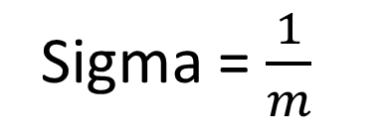
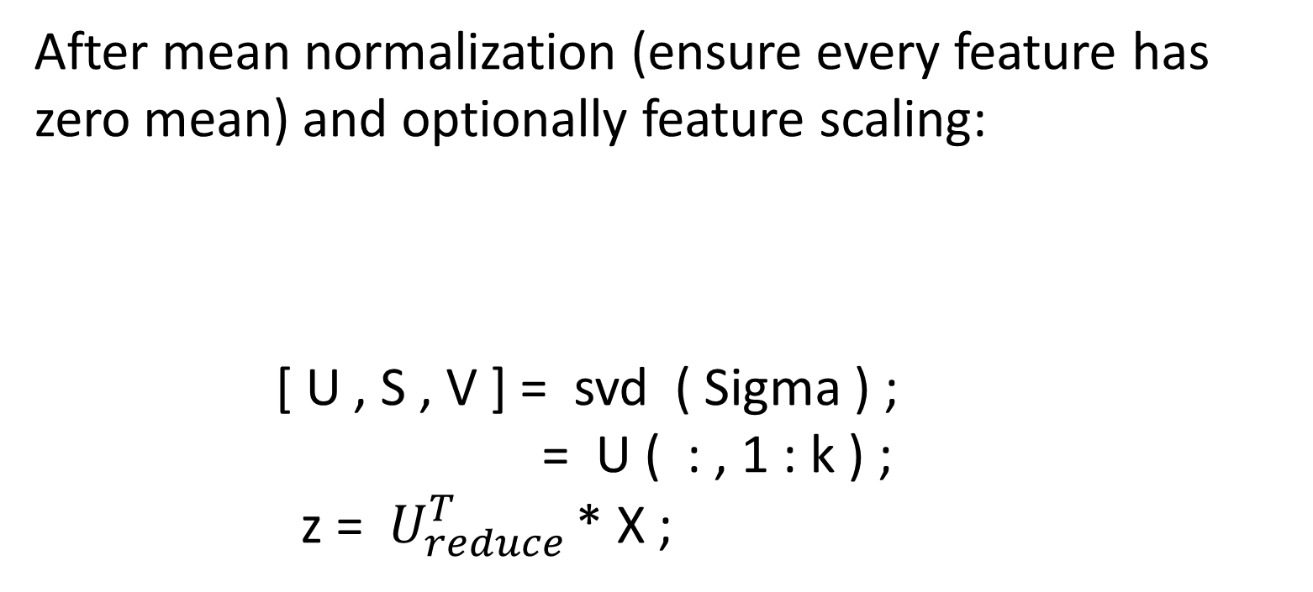

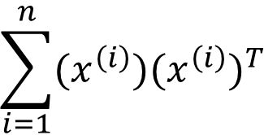
Principal component analysis (PCA) algorithm summary
After mean normalization (ensure every feature has zero mean) and optionally feature scaling:
[ U , S , V ] = svd ( Sigma ) ;
= U ( : , 1 : k ) ;
z = $U_{reduce }^{T}$* X ;
$$\sum_{i=1}^{n}{{(x^{\left(i\right)}{)(x}^{\left(i\right)})}^{T}}$$
Sigma = $\frac{1}{m}$
$U_{reduce}$

Slide 27
PCA algorithm- 2D to 1D
clear ; close all; clc
load ('data1.mat');
[X_norm, mu, sigma] = featureNormalize(X);
[U, S] = pca(X_norm);
plot(X_norm(:, 1), X_norm(:, 2), 'bo');
axis([-4 3 -4 3]); axis square
K = 1;
Z = projectData(X_norm, U, K);
X_rec = recoverData(Z, U, K);
hold on;
plot(X_rec(:, 1), X_rec(:, 2), 'ro');
for i = 1:size(X_norm, 1)
drawLine(X_norm(i,:), X_rec(i,:), '--k', 'LineWidth', 1);
end
hold off
p60

Slide 28
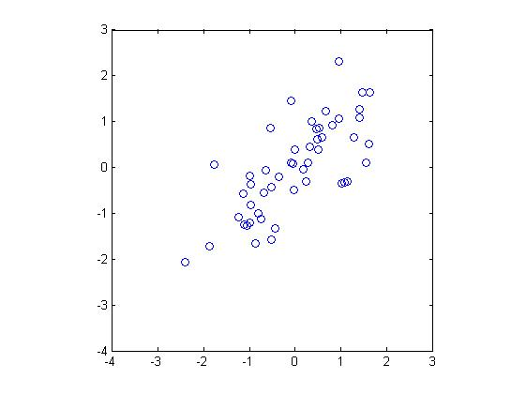
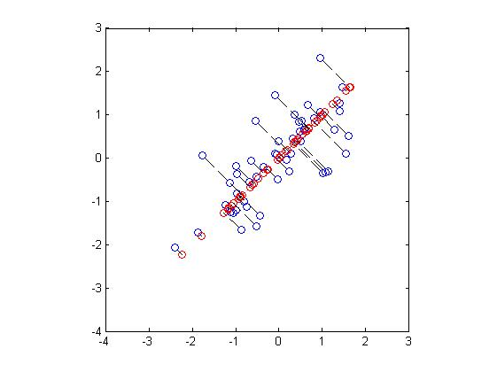
PCA algorithm- 2D to 1D
p60

Slide 29
PCA algorithm- 3D to 2D
pcaV = V(:,1:out_dim);
output_data = input_data * pcaV;
else
% EIG
mean_input_data = mean(input_data);
sub_input_data = input_data - repmat(mean_input_data, count,1);
mean_mat = sub_input_data' * sub_input_data ./ (count - 1);
cov_mat = mean_mat;
[V D] = eig(cov_mat);
% Last out_dim columns as PCA bases
pcaV = V(:,in_dim - out_dim + 1: in_dim);
output_data = input_data * pcaV;
end
%% End Function PCA
%% Visualize Output Data
figure(2);
hold off;
plot(output_data(:,1), output_data(:,2), 'bo');
input_data = rand(1000,3);
%% Visualize Input Data
figure(1);
hold off;
plot3(input_data(:,1), input_data(:,2), input_data(:,3), 'ro');
%% Function PCA, input_data, out_dim
% Use this to switch methods
use_svd_method=1;
out_dim = 2;
[count in_dim] = size(input_data);
% SVD
if (use_svd_method)
sub_input_data = (input_data - repmat(mean(input_data),count,1))/sqrt(count-1);
[U,S,V] = svd(sub_input_data);
% First out_dim columns as PCA bases
p61

Slide 30
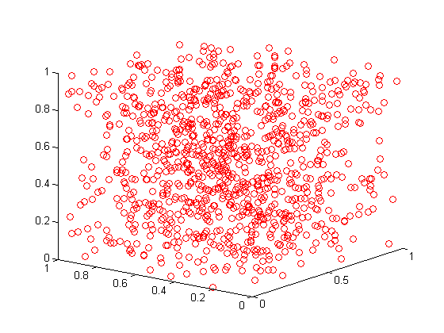
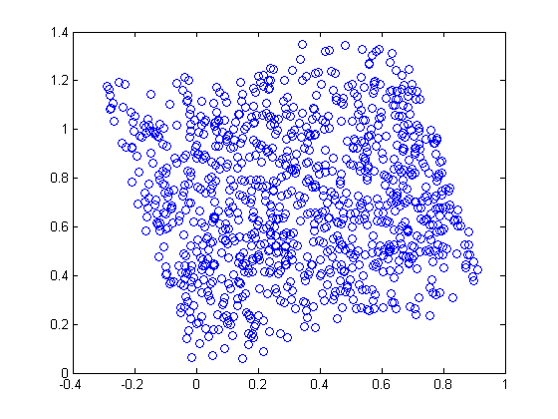
PCA algorithm- 3D to 2D
p61

Slide 31
Choosing the number
of
principal components

Slide 32









Choosing k (number of principal components)
$$\sum_{i=1}^{m}{{∥x^{\left(i\right)}−x_{approx}^{(i)}∥}^{2}}$$
Average squared projection error:
Total variation in the data :
Typically , choose k to be smallest value so that
“99% of variance is retained”
$$\frac{1}{m}$$
$$\frac{1}{m}$$
$$\sum_{i=1}^{m}{{∥x^{(i)}∥}^{2}}$$
$$\sum_{i=1}^{m}{{∥x^{\left(i\right)}−x_{approx}^{(i)}∥}^{2}}$$
$$\frac{1}{m}$$
$$\sum_{i=1}^{m}{{∥x^{(i)}∥}^{2}}$$
$$≪0.01 (1\%)$$
$$\frac{1}{m}$$

Slide 33






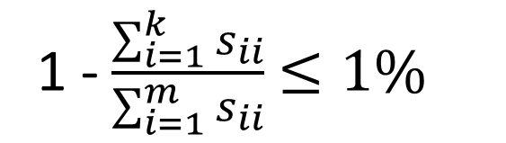

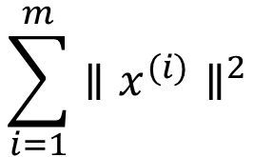




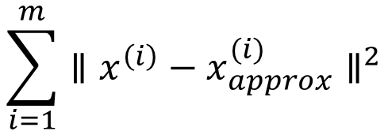

Choosing k (number of principal components)
Algorithm :
Try PCA with k = 1
Compute , , ,…,
, ……..
Check if
[ U ,S ,V ] = svd ( Sigma )
$$U_{reduce}$$
$$z^{(1)}$$
$$z^{(2)}$$
$$z^{(m)}$$
$$S_{11}$$
$$x_{approx}^{(1)}$$
$$x_{approx}^{(m)}$$
$$⋱$$
S =
$$S_{nn}$$
$$\sum_{i=1}^{m}{{∥x^{\left(i\right)}−x_{approx}^{(i)}∥}^{2}}$$
$$\frac{1}{m}$$
$$≪0.01?$$
1 - $\frac{\sum_{i=1}^{k}{s_{ii}}}{\sum_{i=1}^{m}{s_{ii}}}$ $≤1\%$
$$\frac{1}{m}$$
$$\sum_{i=1}^{m}{{∥x^{(i)}∥}^{2}}$$

Slide 34



Choosing k (number of principal components)
[ U ,S ,V ] = svd ( Sigma )
Pick smallest value of k for which
(99% of variance is retained)
$$\sum_{i=1}^{k}{S_{ii}}$$
$$≥0.99$$
$$\sum_{i=1}^{m}{S_{ii}}$$

Slide 35
Reconstruction from
compressed representation

Slide 36
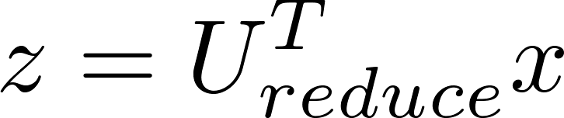
Reconstruction from compressed representation

Slide 37
Recover Data
function X_rec = recoverData(Z, U, K)
%RECOVERDATA Recovers an approximation of the original data when using the
%projected data
% X_rec = RECOVERDATA(Z, U, K) recovers an approximation the
% original data that has been reduced to K dimensions. It returns the
% approximate reconstruction in X_rec.
%
% You need to return the following variables correctly.
X_rec = zeros(size(Z, 1), size(U, 1));
% ====================== YOUR CODE HERE ======================
% Instructions: Compute the approximation of the data by projecting back
% onto the original space using the top K eigenvectors in U.
%
% For the i-th example Z(i,:), the (approximate)
% recovered data for dimension j is given as follows:
% v = Z(i, :)';
% recovered_j = v' * U(j, 1:K)';
%
% Notice that U(j, 1:K) is a row vector.
%
U_reduce = U(:, 1:K);
X_rec = Z * U_reduce';
% =============================================================
end
p60

Slide 38
Advice
for
applying PCA

Slide 39












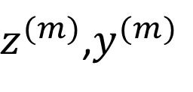




Supervised learning speedup
( ),( ),……( )
$x^{(1)}$,$y^{(1)}$
$x^{(2)}$,$y^{(2)}$
$x^{(m)}$,$y^{(m)}$
Extract inputs:
Unlabeled dataset: , ,…,
PCA
New training set:
( ),( ),…,( )
Note : Mapping should be defined by running PCA only on the training set. This mapping can be applied as well to the example and in the cross validation and test sets.
$$x^{(1)}$$
$$x^{(2)}$$
$$x^{(m)}$$
$$ε R^{10000}$$
$z^{(1)}$,
$z^{(2)}$,…,
$$z^{(m)}$$
$$ε R^{1000}$$
$z^{(1)}$,$y^{(1)}$
$z^{(2)}$,$y^{(2)}$
$z^{(m)}$,$y^{(m)}$
$$x^{(i)}→y^{(i)}$$
$$x_{cv}^{(i)}$$
$$x_{test}^{(i)}$$

Slide 40
Application of PCA
-Compression
-Reduce memory / disk needed to store data
-Speed up learning algorithm
-Visualization

Slide 41



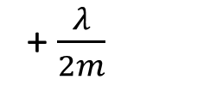
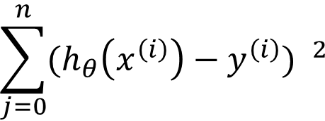
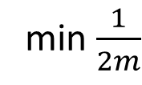
Bad use of PCA: To prevent overfitting
Use instead of to reduce the number of features to k<n.
Thus , fewer features , less likely to overfit .
This might work OK, but isn’t a good way to address overfiting . Use regularization instead.
$z^{(i)}$
$x^{(i)}$
$$\sum_{j=0}^{n}{{(h_{θ}\left(x^{\left(i\right)}\right)−y^{\left(i\right)}) }^{2}}$$
$$\sum_{j=1}^{n}{θ_{j}^{2}}$$
min $\frac{1}{2m}$
+ $\frac{λ}{2m}$

Slide 42






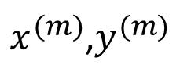
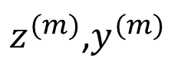






PCA is sometimes used where it shouldn’t be
Design of ML system:
- Get training set{( ) ,( ) ,…,( )}
-Run PCA to reduce in dimension to get
-Train logistic regression on {( ),( ),…,( )}
-Test on test set : Map to .Run on
How about doing the whole thing without using PCA?
Before implementing PCA, first try running whatever you want to do with the original /raw data .Only if that doesn’t do what you want, then implement PCA and consider using .
$x^{(1)}$,$y^{(1)}$
$x^{(2)}$,$y^{(2)}$
$x^{(m)}$,$y^{(m)}$
$x^{(i)}$
$z^{(i)}$
$z^{(1)}$,$y^{(1)}$
$z^{(2)}$,$y^{(2)}$
$z^{(m)}$,$y^{(m)}$
$$x_{test}^{(i)}$$
$$z_{test}^{(i)}$$
$h_{θ}$(z)
{($z_{test}^{(1)}$,$y_{test}^{(1)}$),…,($z_{test}^{(m)}$,$z_{test}^{(m)}$)}
$x^{(i)}$
$z^{(i)}$

Slide 43
Example 1
%======================================
clear ; close all; clc
load ('faces.mat');
displayData(X(1:100, :));
[X_norm, mu, sigma] = featureNormalize(X);
[U, S] = pca(X_norm);
displayData(U(:, 1:36)');
K = 100;
Z = projectData(X_norm, U, K);
X_rec = recoverData(Z, U, K);
% Display normalized data
subplot(1, 2, 1);
displayData(X_norm(1:100,:));
title('Original faces');
axis square;
% Display reconstructed data from only k eigenfaces
subplot(1, 2, 2);
displayData(X_rec(1:100,:));
title('Recovered faces');
axis square;
p62

Slide 44

Example 1 Result
p62

Slide 45
Example 2 face_recongnition
%基于PCA的人脸识别
clear; clc; close all
addpath('./Testing')
addpath('./Training')
N=5;%5个人
M=5;%每个人5幅图
for i=1:N
for j=1:M
image=double(rgb2gray(imread(['orl_00',num2str(i),'_00',num2str(j),'.bmp'])));
x(:,(i-1)*N+j)=reshape(image,size(image,1)*size(image,2),1);%样本矩阵
end
end
meanx=1/(N*M)*sum(x,2);%计算平均脸
A=x-repmat(meanx,1,N*M);%计算差值脸矩阵，每一列是一个差值脸向量
C=1/(N*M)*A‘*A;%计算协方差矩阵
[U,lamda,V]=svd(C);%求特征值、特征向量
eigenvalues = sort(diag(lamda),‘descend’);%特征值降序排列
%选取最大的几个特征值
Tolerance=0.9999;
phi=0;
eigen=0;
eigennum=0;
eigensum=sum(eigenvalues.^2);
while phi<=Tolerance
eigennum=eigennum+1;
eigen=eigen+(eigenvalues(eigennum).^2);
phi=eigen/eigensum;
end
for i=1:eigennum
k=find(diag(lamda)==eigenvalues(i));
w(:,i)=1/eigenvalues(i)*A*V(:,k);
end
save A A
save meanx meanx
save w w
P63

Slide 46
Summary

Slide 47
Summary
The reason of dimensionality reduction:
One is for data compression, reduce memory use , improve the speed of the algorithm;
The second is for the sake of data visualization , and find a better solution to the problem .
PCA algorithm is the most commonly used method of reducing dimension , so this section mainly introduces the basic practice of PCA algorithm , the implementation process , and the methods and precautions to be used.

Slide 48
Thanks
Machine Perception and Interaction Group (MPIG)
www.mpig.com.cn
yhh@mpig.com.cn
公众号:
mpig_robot

